Slide 1
Open-Source LLMs
-Suhas Pai
CTO, Hudson Labs (formerly called Bedrock AI)

Slide 2

About Me
CTO & ML Research @ Hudson Labs
Writing the book ‘Designing LLM Applications’ published by O’Reilly Media.
Co-chair, Privacy working group at Big Science (BLOOM LLM), 2021-2022
Chair, TMLS (Toronto Machine Learning Society) conference
Research: representation learning, text ranking, active learning, model merging

Slide 3
Agenda
01
02
03
04
Navigating the LLM landscape
How to make your LLM SOTA
How to choose the right LLM
Advantages of Open-Source LLMs

Slide 4
Agenda
05
06
07
08
Fine-Tuning LLMs
Creating fine-tuning datasets
LLM Agents
Interfacing LLMs with their environment

Slide 5
01
Navigating the LLM Landscape

Slide 6
Model Flavors
Instruct models
Chat models
Long-context models
Domain or task-adapted models

Slide 7
Candidate LLMs for our exercise
Amber (7B, Chat, Safe)
DeciAI (7B, Instruct)
MPT (7B, Instruct, Chat, Long Context (storywriter)
CerebrasGPT (1.3, 2.7, 6.7)
Pythia (1.4, 2.8, 6.9)
Mistral (7B, Instruct)
Mixtral (8 * 7B, Instruct)
StabilityLM (7B)
RedPajama-INCITE (7B, 3B, Instruct, Chat)
FLAN T-5 (3B, 11B, Instruct)
UL-2 (20B, Instruct)
Falcon (7B, Instruct)
BTLM (3B)

Slide 8
02
How to make your LLM SOTA

Slide 9
Ways to make a better LLM
Training on more tokens
Training with a better data mix
Training with high quality data
Better tokenization
Better learning objectives
Architectural improvements

Slide 10
Architectural Improvements
Grouped Query Attention
ALiBi, RoPE etc (position encoding)
MoE (mixture of experts)
SSM (state-space models)

Slide 11
Why MoE
Scaling Laws says -> MOAR parameters.
But with current paradigm, more parameters = More compute for both training/inference
Can we increase the parameter count (capacity) of a model without increasing required compute?

Slide 12
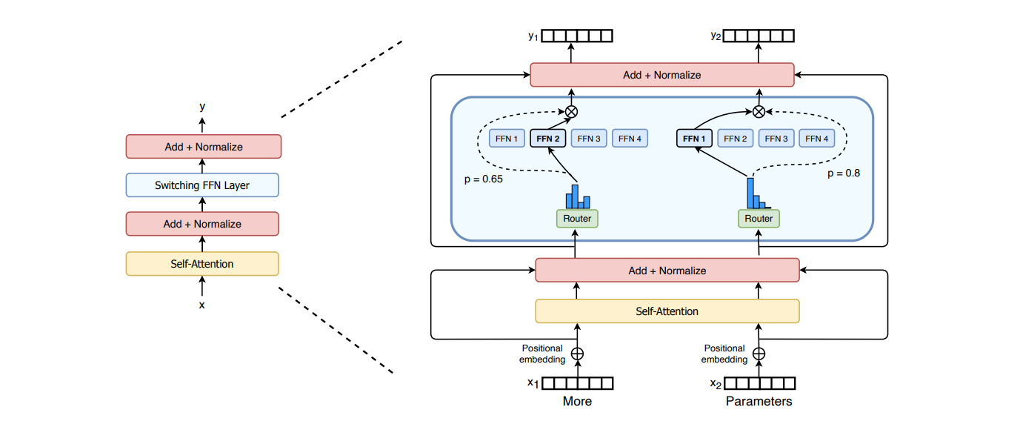
MoE example

Slide 13
Routing Strategies
Based on cumulative distribution
Tokens-choose (top-K)
Experts-choose
Hashing function
Random! (with consistency regularization)

Slide 14
Detour: Mixture of Experts
Grouped Query Attention
ALiBi, RoPE etc (position encoding)
MoE (mixture of experts)
SSM (state-space models)

Slide 15
03
How to choose the right LLM

Slide 16
Considerations
Inference costs
Switching costs
Time per output token
Time to first token
Capabilities required
Performance threshold
Access to MLOPS talent
Access to ML talent
Licensing restrictions
Security, Privacy and other non-functional requirements

Slide 17
LLM Evaluation is hard!
Quantitative evaluation using benchmark datasets
Human evaluation
LLM-driven evaluation

Slide 18
Quantitative LLM Evaluations
Eleuther AI Evaluation Harness
OpenLLM leaderboard (based on Eleuther AI harness)
HELM
LMSYS (ELO ratings)

Slide 19
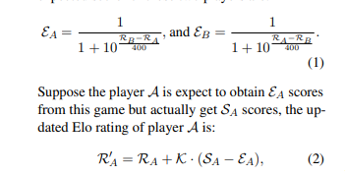
Human Evaluation
Elo, Multi-Elo Ratings
Wu et al. ‘Evaluation Biases for Large Language Models
https://github.com/h2oai/h2o-LLM-eval

Slide 20
Challenges with Human Evaluation
Humans tend to overlook substance when style is impressive
Humans tend to prefer longer answers
Humans tend to prefer the first option
Tip: Conduct blind tests, provide random ordering

Slide 21
Example Criteria for Human Evaluation - Summarization
Coherence
Completeness
Factuality
Repetitiveness
Relevance
Structure
Specificity
Formatting

Slide 22
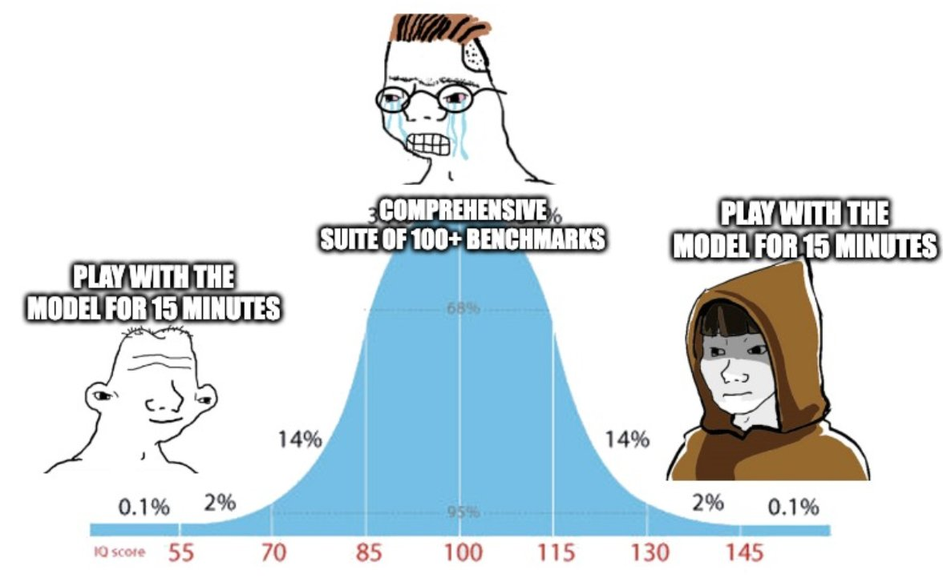
In reality…
Image Credit: Jason Wei

Slide 23
04
Advantages of open-source LLMs

Slide 24
Advantages of Open-Source LLMs
Flexibility
Transparency
Cost (not always)
Safety & Alignment (controversial)

Slide 25
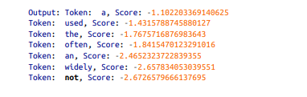
Open Source LLMs - Flexibility
Analyze output token distribution.
Continuation of the sequence ‘Language Models are’ using GPT-Neo

Slide 26
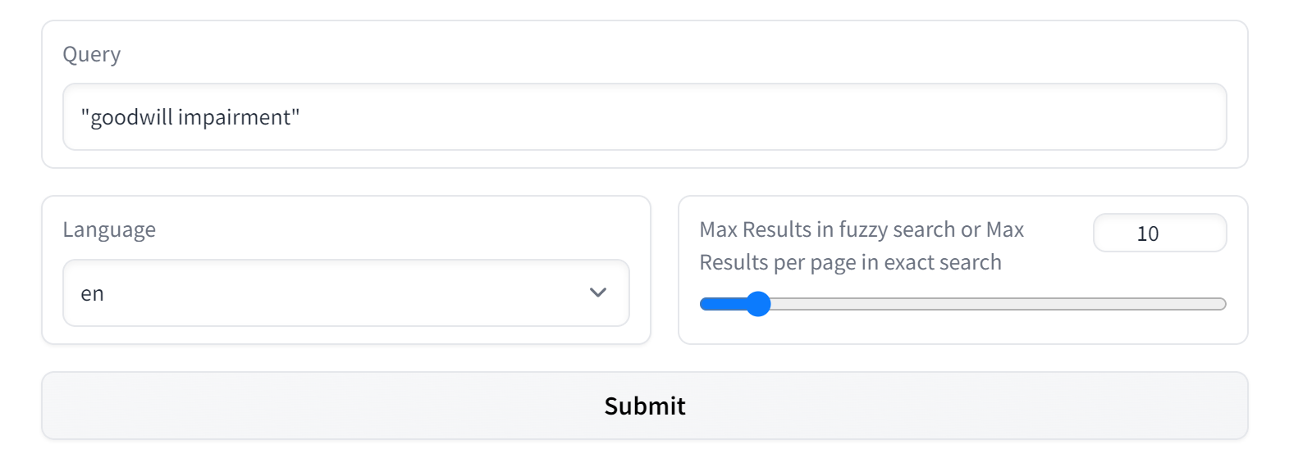
Open Source LLMs - Transparency
Roots Search Tool - BLOOM

Slide 27
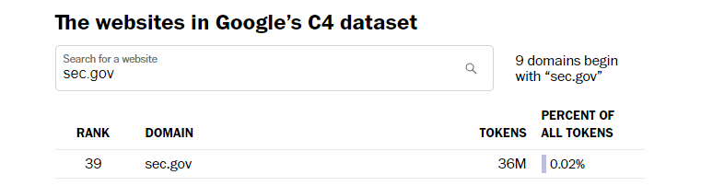
Open Source LLMs - Transparency
C4 search tool - https://c4-search.apps.allenai.org/

Slide 28
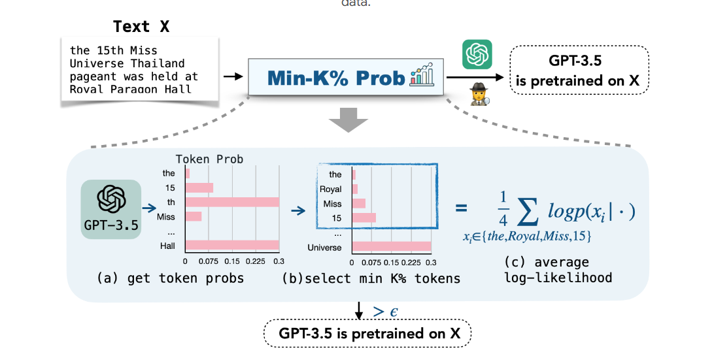
Verify if content is present in training set
Shi et al. ‘Detecting pre-training data from Large Language Models

Slide 29
Caution
Not all open-source models are fully open
Usage restrictions abound
Datasets are mostly kept secret

Slide 30
Open Source LLMs - Cost
Deployment ecosystem for open-source models is not yet mature
Self-hosting is challenging and needs MLOPS effort, especially if need to optimize latency/throughput.
BigTech/VCs are subsidizing inference cost in the short-term.

Slide 31
Open Source LLMs - Safety & Alignment
Enables users to integrate application-specific safety and alignment measures
‘Security by obscurity’ has never worked in the world of information security.

Slide 32
Caution
Beware of shallow imitation
Scale of model is still the most important determinant

Slide 33
Switching costs are hard
Extremely sensitive to prompting strategies
Extremely sensitive to decoding strategies
In most cases, it really isn’t worth switching over to a new LLM that exhibits incremental improvements.

Slide 34
05
Fine-tuning LLMs

Slide 35
Arguments - Optimizers
Learning Rate
Optimization Algorithm
Learning Schedule

Slide 36
Arguments - Memory Optimization
Gradient Accumulation
Gradient Checkpointing
Quantization

Slide 37
Arguments - Regularization
Dropout
Label Smoothing
Noise Embeddings

Slide 38
06
Creating fine-tuning datasets

Slide 39
Instruction-tuning
LLMs are like rebellious teenagers - it is hard to use base models to get to do what you want it to.
Help LLMs learn to follow instructions using instruction tuning

Slide 40
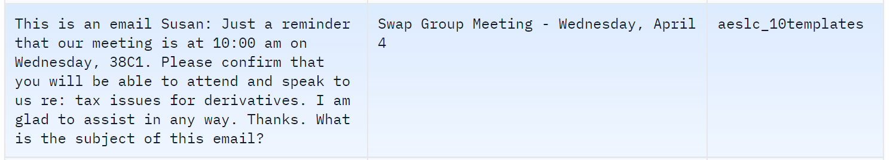
Instruction-tuning datasets
FLAN dataset
Instruction
Input
Output

Slide 41
Current strategies for creating instruction tuning datasets
Take an existing fine-tuning dataset and augment it with templated instructions
Start from a seed set of instruction-input-outputs, use an LLM to generate similar instructions

Slide 42
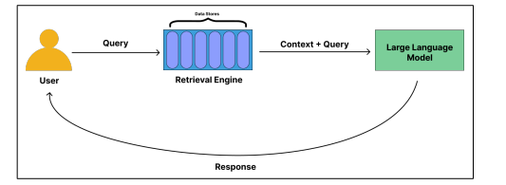
Instruction Tuning for helping Retrieval-based use cases
Create instruction-tuning dataset that replicates this scenario, i.e collating information from top-k retrieved textual units to produce a coherent answer.

Slide 43
07
Interfacing LLMs with their environment

Slide 44
Prompt Hacking (Prompt Engineering)
You can’t prompt your way out of hallucinations! But it can help reduce them.
logit_bias, presence_penalty in the Open AI API can be used in very inventive ways to control output.

Slide 45
Enable LLM to interact with its environment
Memory & Data Stores
Models & Software (Tools)
Self-augment

Slide 46
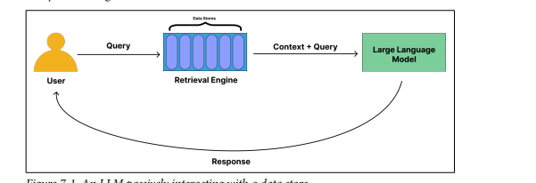
Paradigms - The Passive Approach

Slide 47
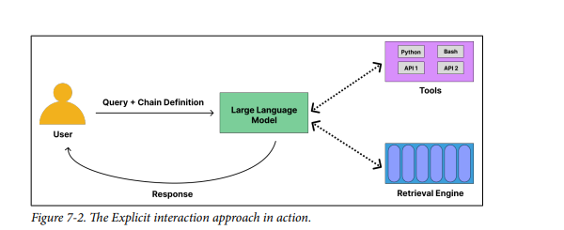
Paradigms - The Active Approach

Slide 48
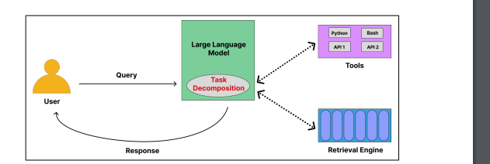
Paradigms - The Agentic Approach

Slide 49
08
LLM Agents

Slide 50
Agentic Approach - Steps Involved
Task Decomposition & Planning
Retrieval
Tool Selection
Tool Invocation
Answer Generation
Answer Verification
Clarification

Slide 51
Thanks!
Do you have any questions?
piesauce@gmail.com
https://www.piesauce.com
https://twitter.com/piesauce

